Slide 1
Waste Classification System Using Machine Learning
B.Sc. Final-Defense
Md Arif Billah
ID : 221-15-5842
&
Sifat Khan
ID : 221-15-5869
Department : CSE
Daffodil International University

Slide 2
Outline
Introduction
Research Question
Objective
Background Study
Gap Analysis
Methodology
Results & Analysis
Novelty of the Work
Sample Dataset
Web Interface
Conclusion
References
B.Sc. Final-Defense

Slide 3

Introduction
Waste mismanagement is a major environmental issue that leads to pollution, health hazards, and inefficient recycling. Manual waste sorting is slow, unsafe, and error-prone, creating a need for smart automated solutions. Machine Learning offers the ability to classify waste accurately using image-based deep learning techniques.
Manual waste sorting is unsafe, time-consuming, and inconsistent.
Deep learning enables automatic identification of waste types from images.
Models like MobileNetV2, ResNet50, EfficientNet, and YOLOv3 improve accuracy and real-time detection.
Automated waste classification supports recycling, sustainability, and smart waste management.
B.Sc. Final-Defense

Slide 4
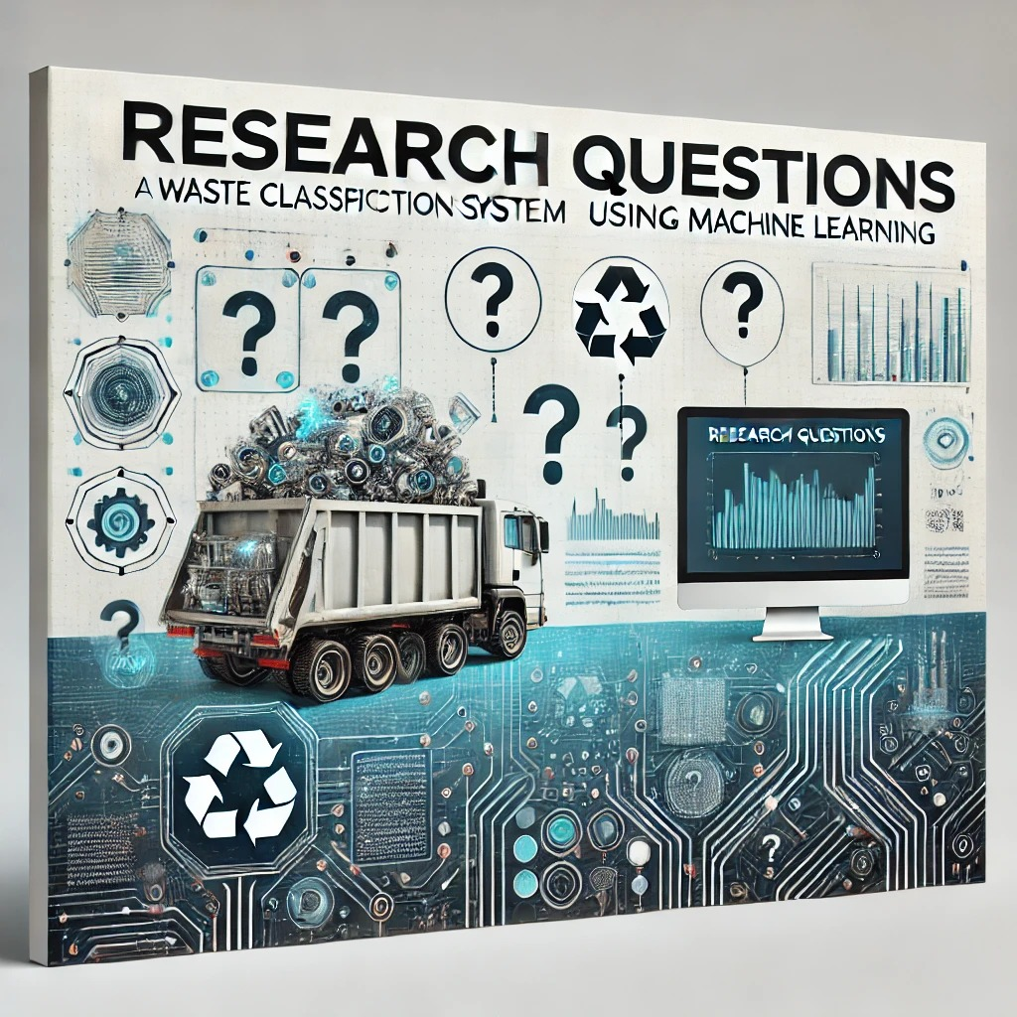
Research Question
How effectively can machine learning models classify waste into Plastic, Metal, Glass, and Polythene?
How can AI-based classification contribute to sustainable waste management?

Slide 5

Objective
The objective of this project is to develop an intelligent waste classification system that automatically identifies different categories of waste using machine learning techniques. This system aims to support smart waste management by improving accuracy, efficiency, and sustainability..
Specific Objectives
To design and develop an ML-based model capable of classifying waste images into predefined categories.
To build a structured dataset by collecting, preprocessing, and labeling waste images.
To evaluate the performance of different machine learning models and select the best-performing one.
To contribute to sustainable waste management by reducing manual effort and improving recycling efficiency.
B.Sc. Final-Defense

Slide 6
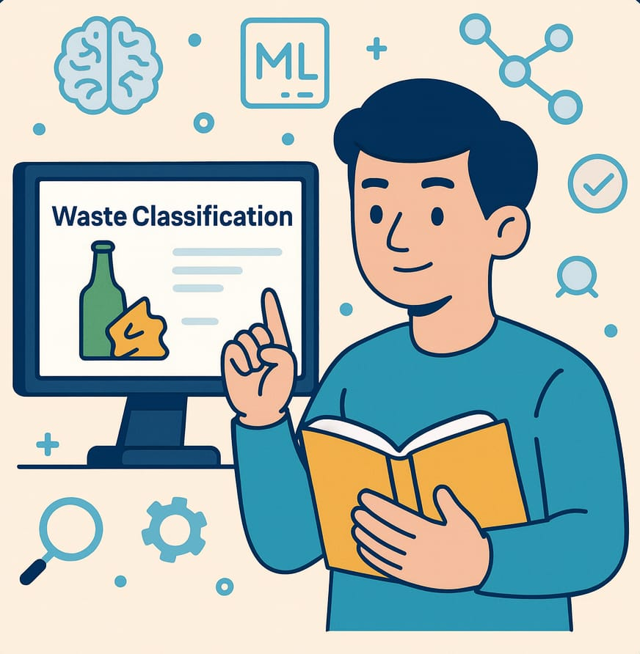
Background Study
Waste classification plays a crucial role in modern waste management systems. Traditional manual sorting is slow, unsafe, and often inaccurate. With advancements in computer vision and deep learning, automated waste classification has become an effective solution for improving recycling efficiency and environmental sustainability.
Key Points
Deep Learning models such as CNNs are widely used for image classification tasks.
Transfer learning models (MobileNetV2, ResNet50, EfficientNet) provide high accuracy with reduced computation.
YOLO-based object detection supports real-time multi-waste detection in a single image.
Automated classification systems can significantly reduce human effort and environmental risks.
B.Sc. Final-Defense

Slide 7

Gap Analysis
Existing systems mostly focus on single-object classification, not multi-object waste detection.
Many research datasets lack real-world diversity (lighting variations, cluttered backgrounds).
Limited studies address Polithin vs Plastic confusion due to visual similarity.
Few works implement a hybrid model combining classification + detection.
Most traditional waste sorting methods rely on manual labor, leading to inaccuracy and health risks.
Existing ML models struggle with transparent waste and overlapping objects.
Real-time waste detection is missing in many previous systems.
B.Sc. Final-Defense

Slide 8
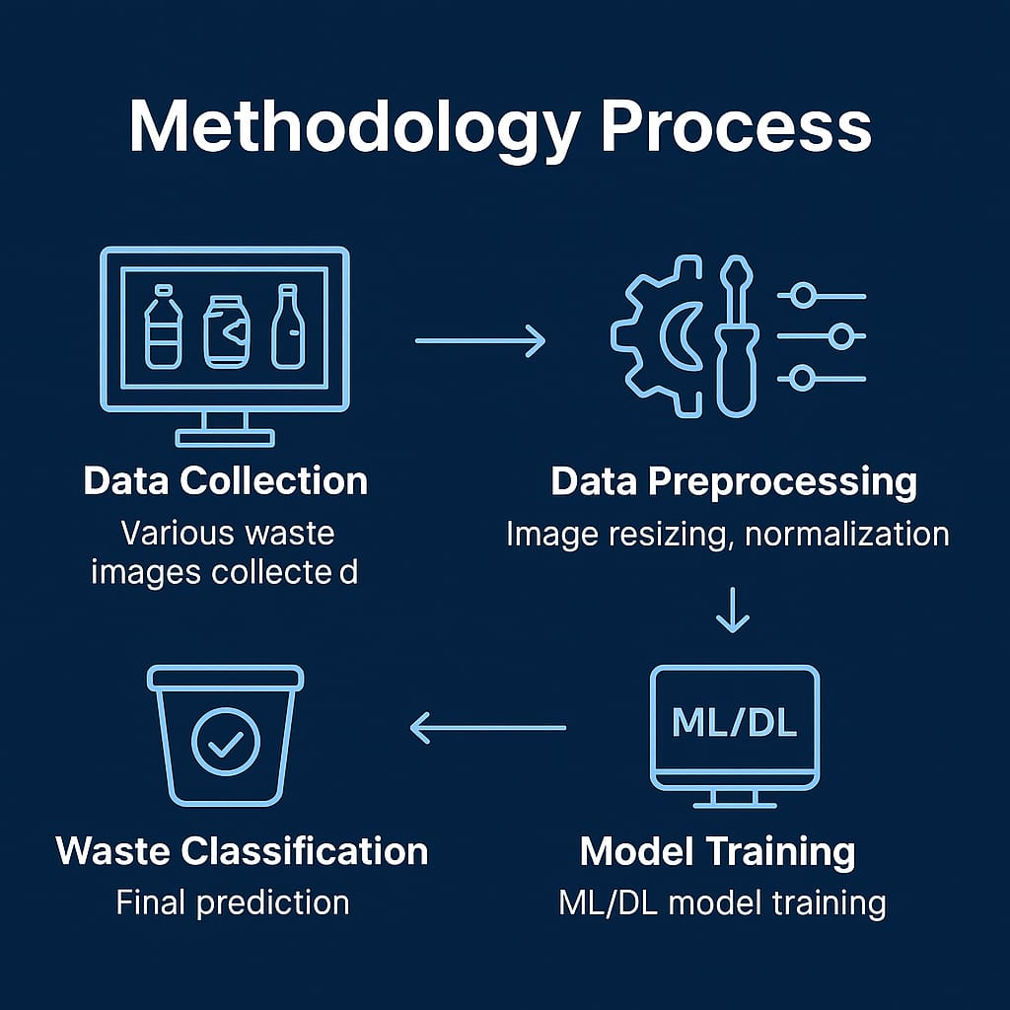
Methodology
Data Preprocessing
Model Evaluation
MobileNetV2, ResNet50, EfficientNet
YOLOv3
Data Collection
Evaluation
Accuracy, Precision, Recall, F1-score,
Result Generation
B.Sc. Final-Defense

Slide 9
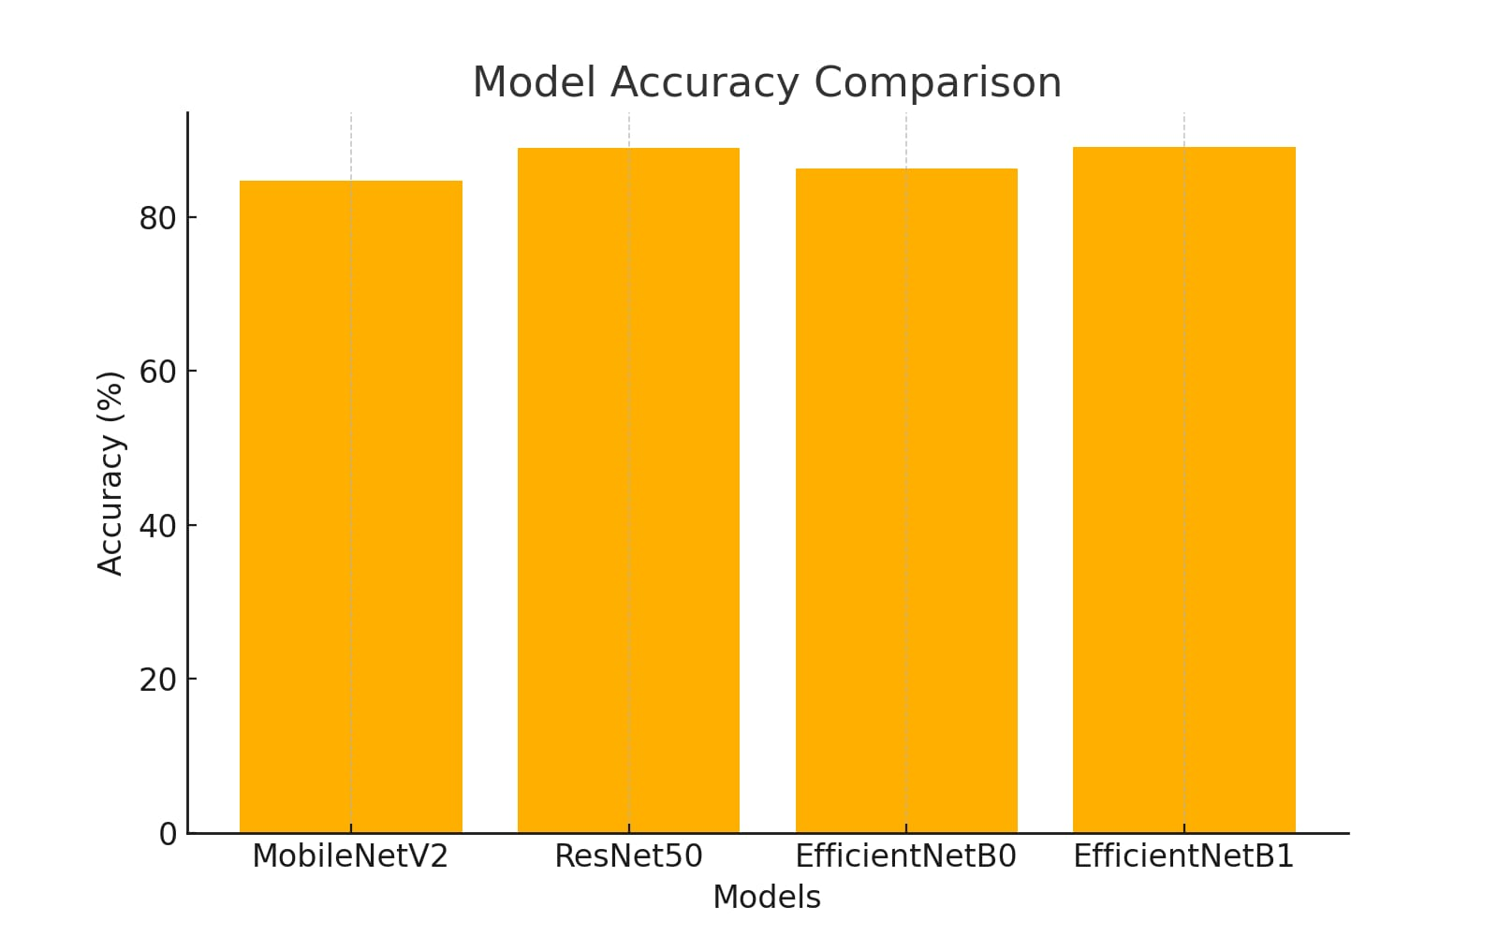
Result and Analysis
Overall Model Performance
Model Name | Accuracy (%) | Precision (%) | Recall (%) | F1-Score (%)
MobileNetV2 | 84.72 | 85.10 | 83.40 | 84.23
ResNet50 | 88.95 | 89.60 | 88.10 | 88.84
EfficientNetB0 | 86.32 | 87.00 | 85.90 | 86.44
EfficientNetB1 | 89.12 | 89.80 | 88.50 | 89.14
B.Sc. Final-Defense

Slide 10
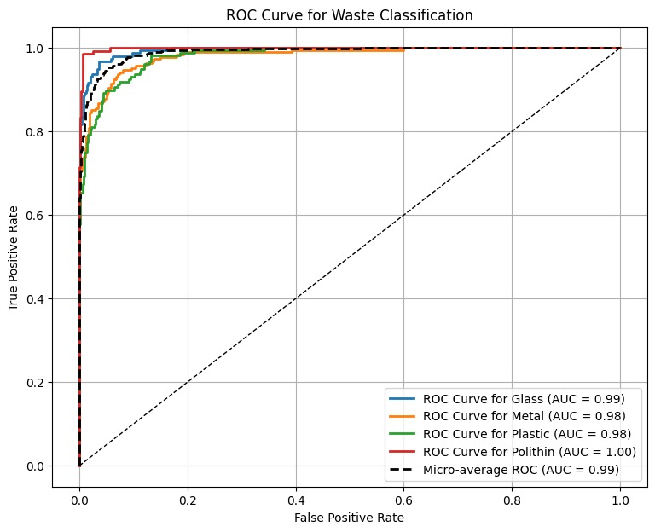
Result and Analysis
ROC Curve Insights
The ROC curve indicates excellent model performance across all waste classes.
All class curves remain close to the top-left region, meaning high true positive rates.
AUC values between 0.98–1.00 show very strong discriminative ability.
The model reliably distinguishes Plastic, Metal, Glass, and Polithin with minimal false positives.
Overall, the ROC curve confirms a highly accurate and stable classification system.
B.Sc. Final-Defense

Slide 11

Novelty of the Work
Hybrid Approach: Integration of classification models (MobileNetV2, ResNet50, EfficientNet) with YOLOv3 detection for both single-object and multi-object waste recognition.
Real-World Dataset: A custom dataset of 3000+ images, including self-captured images with diverse lighting and background conditions.
High Accuracy: Achieved 89.12% accuracy with EfficientNetB1, outperforming many existing systems.
Scalable Design: The system can be extended to new waste categories and deployed on low-power edge devices (MobileNet/ EfficientNet support).
B.Sc. Final-Defense

Slide 12
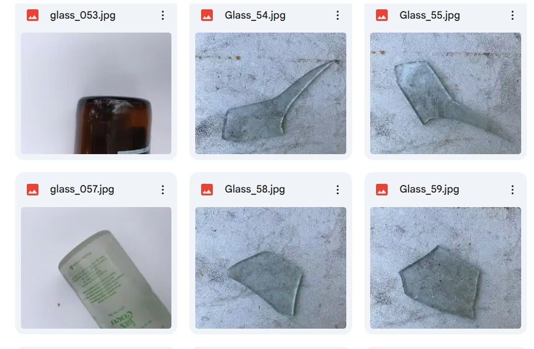
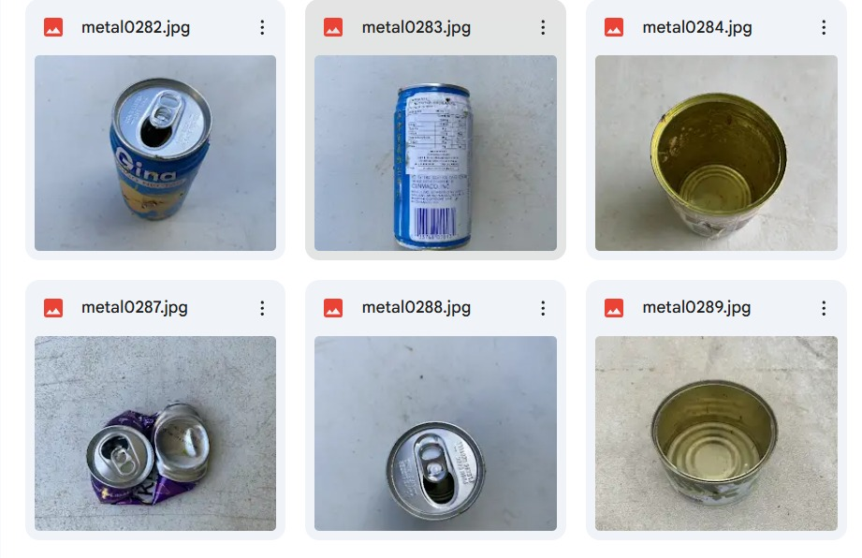
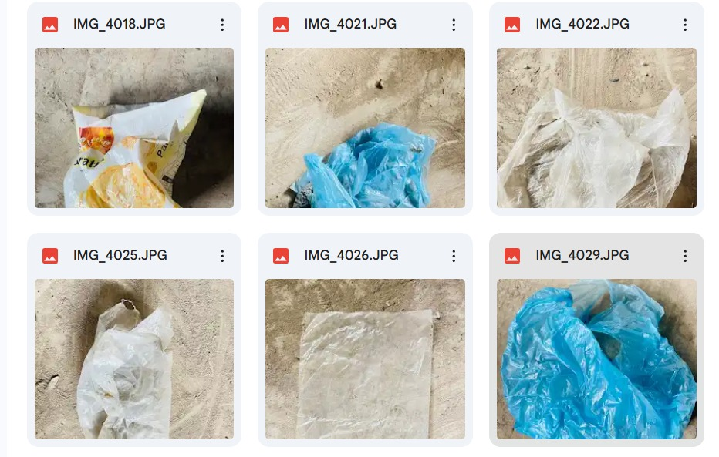
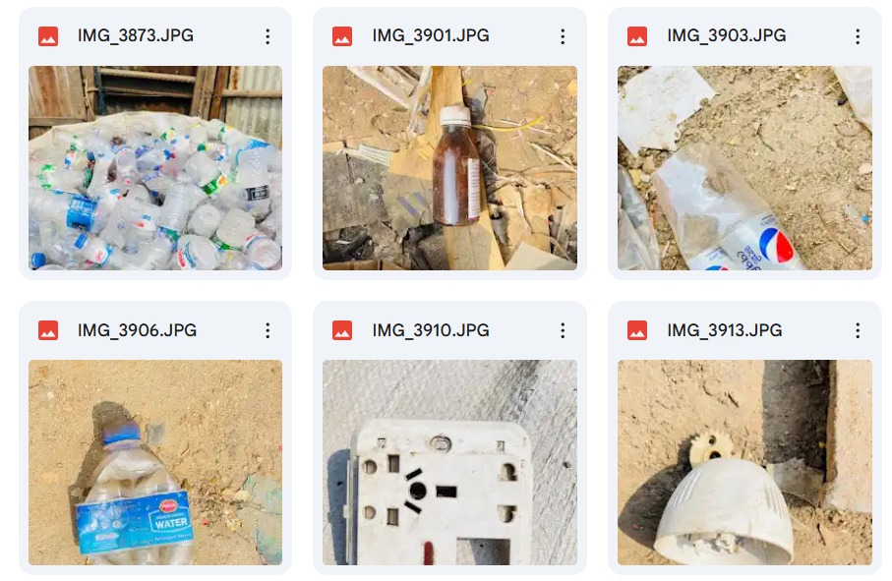
Sample dataset
B.Sc. Final-Defense

Slide 13
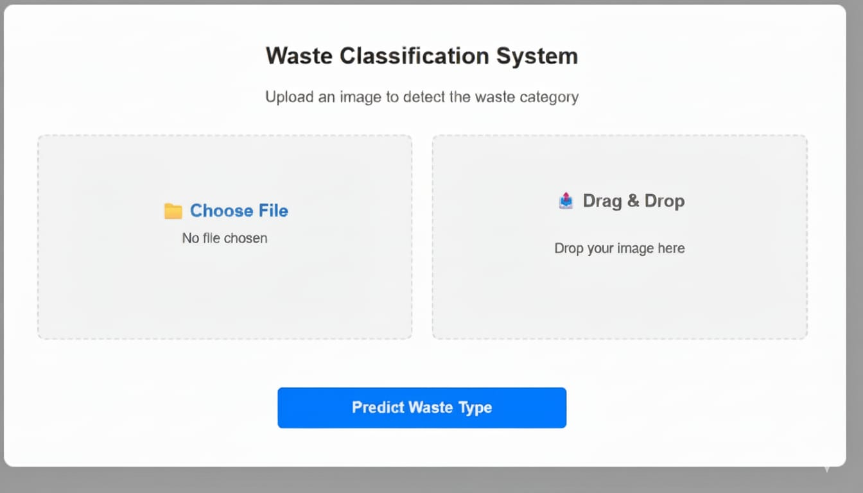
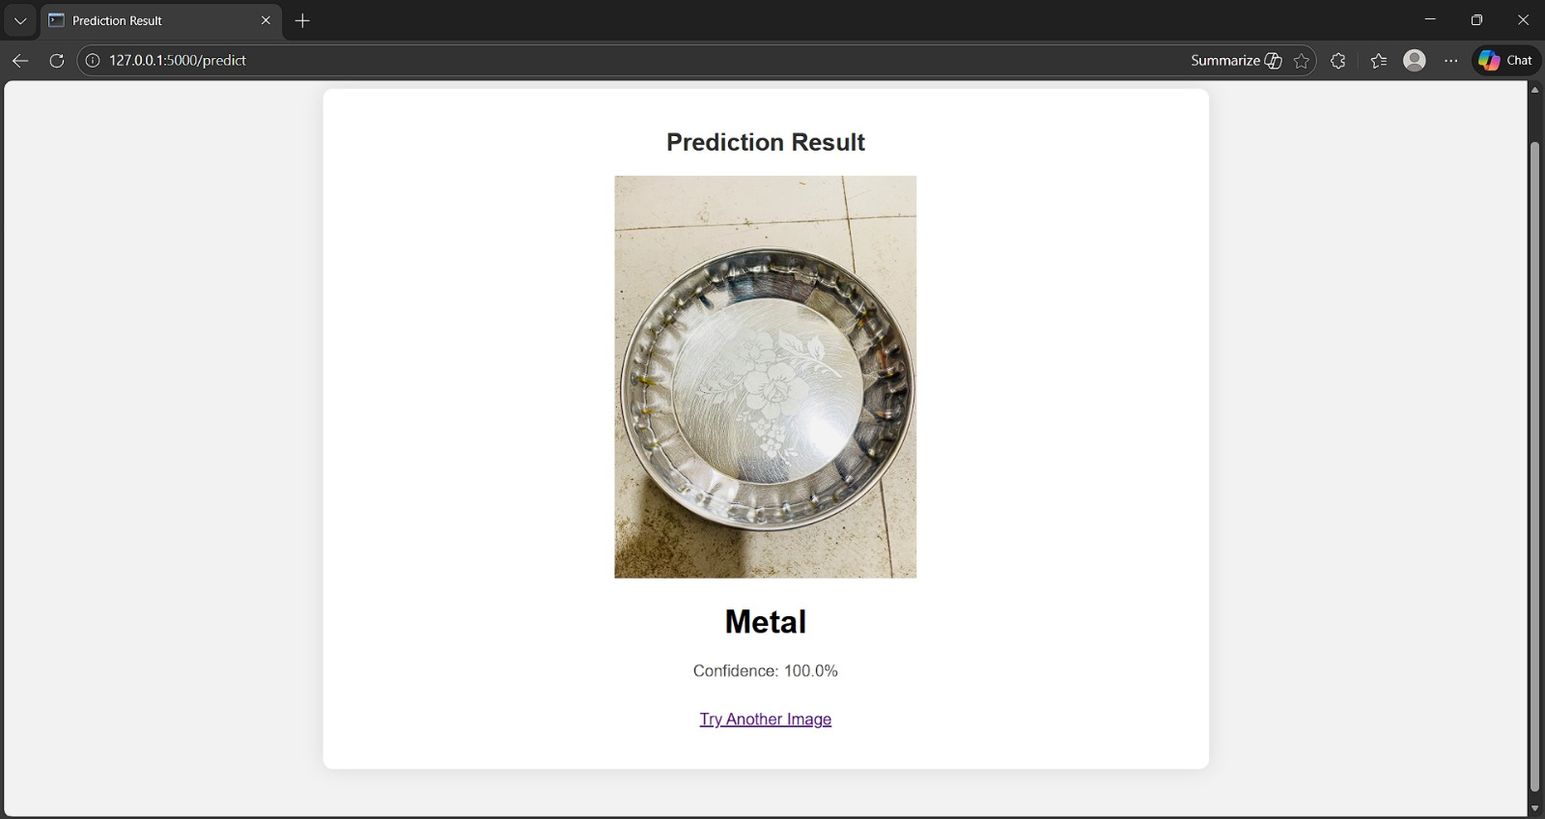
Web Interface of Waste Classification
B.Sc. Final-Defense

Slide 14

Conclusion
This project successfully developed an AI-based waste classification system capable of identifying and detecting multiple waste categories using deep learning. The system demonstrates strong potential for real-world deployment in smart waste management and recycling environments.
Successfully built a dataset of 3000+ waste images across four categories.
Implemented multiple ML models, where EfficientNetB1 achieved highest accuracy (89.12%).
Demonstrates potential to reduce manual labor, improve recycling, and support environmental sustainability.
B.Sc. Final-Defense

Slide 15
References
Lin, Kunsen, et al. "Toward smarter management and recovery of municipal solid waste: A critical review on deep learning approaches." Journal of Cleaner Production 346 (2022): 130943.
Jahan, Israt, et al. "Deep Learning-Driven Real-Time Visual Pollution Detection and Multi-Class Waste Classification in Urban and Textile Landscapes." Procedia Computer Science 252 (2025): 529-538.
Adedeji, Olugboja, and Zenghui Wang. "Intelligent waste classification system using deep learning convolutional neural network." Procedia Manufacturing 35 (2019): 607-612.
Shreya, M., Jyotika Katyal, and R. J. W. M. Ramesh. "Technical solutions for waste classification and management: A mini-review." Waste Management & Research 41.4 (2022): 801.
8. Amin, Zian Md Afique, Khan Nasik Sami, and Raini Hassan. "An approach of classifying waste using transfer learning method." International Journal on Perceptive and Cognitive Computing 7.1 (2021): 41-52.
B.Sc. Final-Defense

Slide 16
THANK YOU
B.Sc. Final-Defense

